Slide 1
无线传感器网位置隐私

Slide 2
Contents
1. Privacy in WSNs
2. Some Typical Schemes
3. A Specific Scheme(Source)

Slide 3
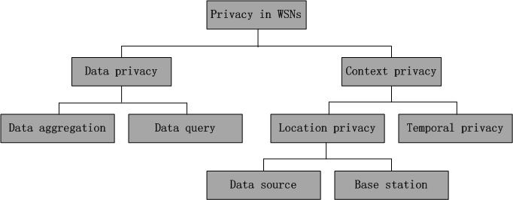
1. Privacy in WSNs
Two broad categories:
  content-oriented
  context-oriented
WSNs中隐私的分类

Slide 4
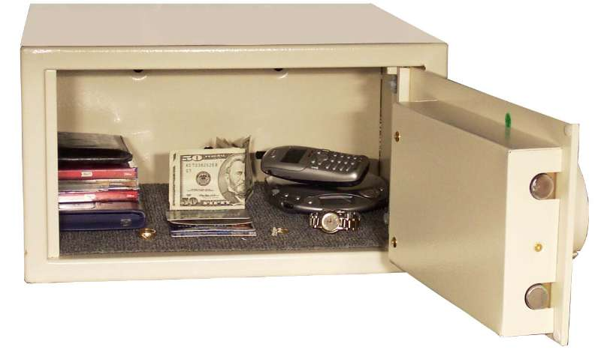
Content-oriented Security/Privacy
Security of the contents of messages.
Cryptographic methods.

Slide 5

Contextual Privacy
Deals with context in which the sensor application works.
时间、地点、周围环境等

Slide 6
Panda-Hunter Game
Source periodically sends data to sink through multi-hop routing
Assume single panda, source, and sink
An Attacker wants to locate the panda
Privacy cautious routing technique prevents hunter from locating source

Slide 7

The Hunter（攻击者）
Non-malicious – does not interfere with network
Device-rich – has devices to measure angle of arriving message
Resource-rich – move at any rate and unlimited power
Informed – knows how the network works

Slide 8



Example Scenario
source
sink
  The panda-hunter game（隐私保护文章中多次使用的一个场景）

Slide 9
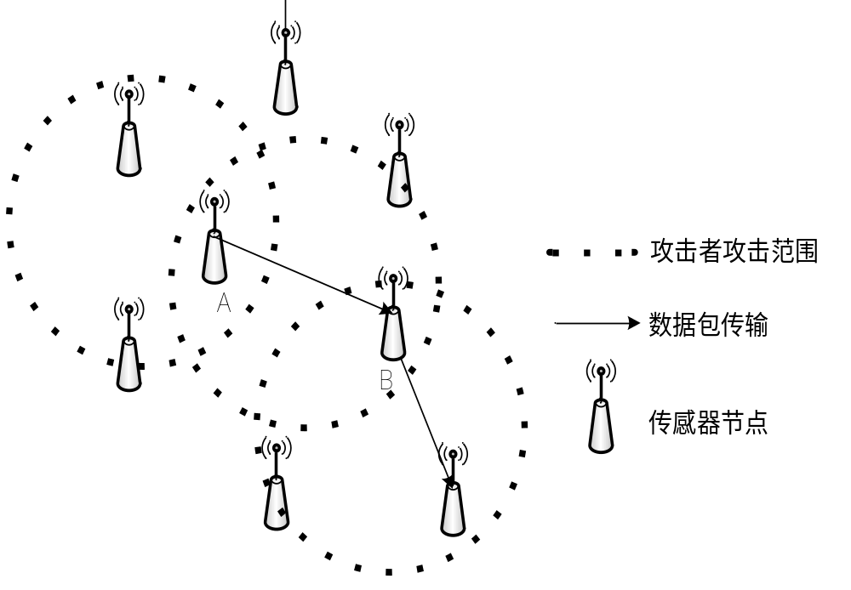
攻击者
流量分析的攻击者
逐跳追踪的攻击者
（重点）
跟踪方式：从sink（BS）开始追踪

Slide 10
攻击1：逐跳追踪数据包
外部攻击者通常配备某种无线信号定位装置，对一定范围内的数据包传输行为进行监控。在追踪源节点位置时，其追踪的方向与数据包的传输方向相反。
具体描述为:攻击者首先位于汇聚节点处监听局部范围内的无线信号，监测到一个新的信号后判断信号发送节点的位置，并移动到该信号发送点位置继续监听无线信号，最终以逐跳的方式从汇聚节点追踪到源节点位置。
www.themegallery.com

Slide 11
攻击2：流量分析
攻击者可以通过在网络中布置大量廉价的监控设备来实现全局监控。通过观察网络的通信流量模式，攻击者能够定位出源节点或汇聚节点的准确位置。
www.themegallery.com

Slide 12
流量分析攻击主要分为两种：
rate monitoring attack && time correlation attack
rate monitoring attack: 攻击者监测其附近的节点的包发送率（packet monitoring rate），并且向高包发送率的节点移动。通俗地讲，就是监测网络中的流量大小，攻击者向流量大的地方移动。
time correlation attack: 攻击者通过观察某节点与其邻居节点之间的发送时间的相关性，推断出路径来by following the “sound” of each forwarding operation。

Slide 13
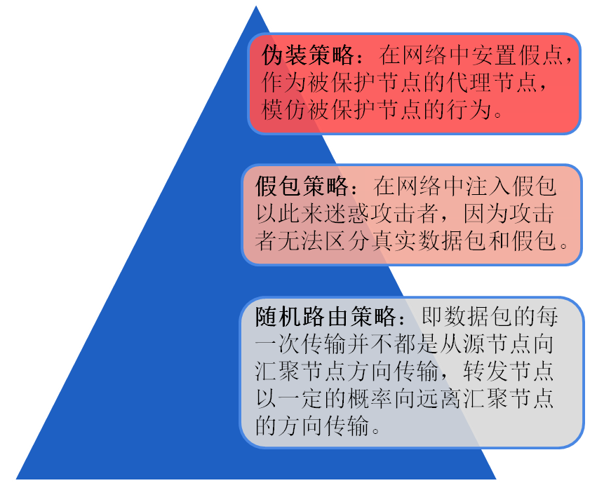
2.典型的位置隐私保护策略
主要策略

Slide 14
routing protocols to protect privacy
Two baseline techniques
  flooding
    message is broadcasted to all neighbors
  single-path routing
    message is routed to one of the neighbors

Slide 15
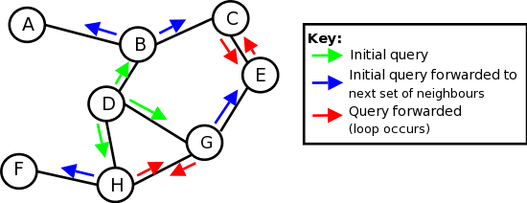
Routing Techniques - Flooding
Flooding-based: source sends the message to all its neighbors, who in turn do the same.
If node has received it already, the node discards it.
Performance drawbacks, but easy implementation.

Slide 16

Probabilistic Flooding
Like flooding, but with a probability.
When a node receives a message, it randomly generates a number uniformly distributed between 0 and 1.
If # < forwarding probability, it sends, otherwise, it doesn't.

Slide 17
Privacy of Routing Techniques
Problems with single-path and flooding
  Single-path reduces energy, but poor at protecting source-location privacy.
  Flooding isn't any better, because the shortest-path is still contained within the flood.
  Probabilistic flooding helps – higher safety period, but at the cost of delivery ratio.
There is room for improvement.
  Maybe trick the hunter?

Slide 18
Improvement（1）: routing with fake sources
introduce new sources that inject fake messages into the network
  two challenges:
    How to chose fake source
    Rate of fake messaging

Slide 19
Routing with fake sources
Fake source
  source is h hops away, sends message to the sink
  sink sends a message into opposite direction
  once message reached node in h hops away from sink it becomes a fake source
real source
fake source

Slide 20

Fake Sources
Multiple ways this can be done.
  Short-lived – similar to probabilistic flooding.
  Short-lived fake sources can only draw the hunter away momentarily.
  A persistent fake source，which is more effective, but requires a global overview of network.

Slide 21
Fake Sources
Rate of fake messaging
  Slow rate →hunter finds the real source fast
  At the rate of the real messaging → hunter struggles between fake and real source
  High rate → hunter is kept at the fake source
  Works best when fake source sends at higher rate than real source, but requires large energy budget.

Slide 22
Problem with Fake Sources: Perceptive Hunter
Recall the assumptions on our hunter – he's informed.
Once he realizes the fake source, he knows which direction to go for the real source.
We need a new approach.
Perceptive hunter model
hunter is able to detect deception
  for ex. can keep the history of visited nodes

Slide 23
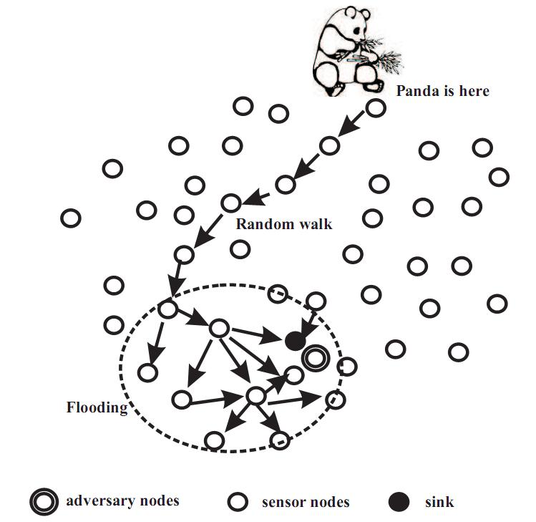
Improvement（2）:
Phantom Routing幻影路由
Idea: entice hunter to phantom instead of source.
幻影路由协议是在数据包的传输过程中引入一个随机转发过程，从而防止外部攻击者利用无线电设备对无线信号进行反向追踪，获取源节点的位置。

Slide 24

Including two phases:
  random walk
    message is routed in random fashion for h hops
  flooding/single-path routing
    after h hops message is routed using baseline technique
Random walk
Flooding

Slide 25
Performance metrics
the safety period
  number of messages initiated by the sensor monitoring the panda. 一般拿时间衡量
the capture likelihood
  the probability that hunter can capture panda within a specified time period.

Slide 26
Energy Consumption
  messages sent.
Delivery Quality
  avg. msg. latency, delivery ratio.

Slide 27
Privacy in mobile sensor network
Mobility adds privacy
  Fast moving panda alone is sufficient to provide source privacy using single-source routing
  In phantom routing the privacy increases

Slide 28

Mobile Source
Need to rethink entire process again.
Depends on panda's movement pattern and velocity.

Slide 29
Improvement（3）: 环路陷阱路由协议
环路陷阱协议是一种基于垃圾包的源位置隐私保护协
议，其基本思想是利用网络中预先设置好的垃圾包环路来迷惑攻击者的追踪。
节点在网络预布置阶段以一定的产生概率预先建立起一系列环路。数据传播时，源节点沿最短路径向汇聚节点传输数据，若传输路径上的节点同时是某个环路上的节点就激活经过该节点的所有环路，同时在环路上以同样的速率发送垃圾包。

Slide 30
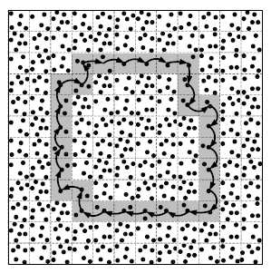
优点：
1）外部攻击者无法破解包内容，也就无法对真实数据包和垃圾包进行区分，因此会以一定的概率被吸引到环路上去，并会在环路上持续追踪，直到重新回到数据传输路径上，从而延缓了攻击者追踪从汇聚节点追踪到源节点的时间。
缺点：
2）发送垃圾包会很大程度上增加网络的能量消耗，会使局部的能量消耗过多，流量过大，网络的寿命会减少。
3)所有的环路都是预先布置好的静态的环，这使得环路对于能力增强的攻击者不起作用，如能观察较大区域中流量的攻击者或能够记录所有已经到达过节点位置的攻击者。
www.themegallery.com

Slide 31
优点及问题
优点
与NMR(Li Yun)那篇文章相比，
对于假包的发送，location privacy against traffic analysis attacks in WSNs里假包是由转发某数据包的远邻居以一定概率产生的，但是他采用的是flooding的方式，我们不是采用flooding的方式，这样的话，我们在假包消耗能量这方面能量消耗相对较小。且我们让远邻居和近邻居都发送假包，这样对source的保护程度更好，但是我们让邻居节点发送假包的概率要比那篇文章中的要小，这样才能使在消耗能量少的情况下，获得相对较好的保护程度。

Slide 32

Improvement（4）基于多环的源位置隐私保护方案

Slide 33
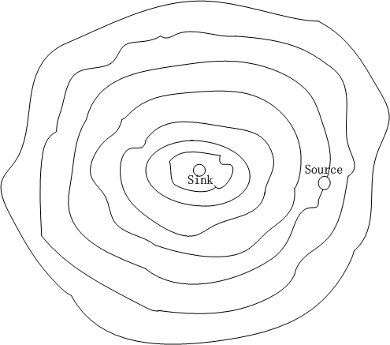
网络模型
  把网络中所有的节点，都集中在多个环（并不一定是环，也可以是不标准的形状，但是是封闭的形状）上。具体的，我们假设sink节点在中间位置，距离sink一跳的节点可以组成1环，距离2跳的组成2环，…，距离n跳的为n环，比较理想的情况下，所有的节点都会在这n个环上。

Slide 34
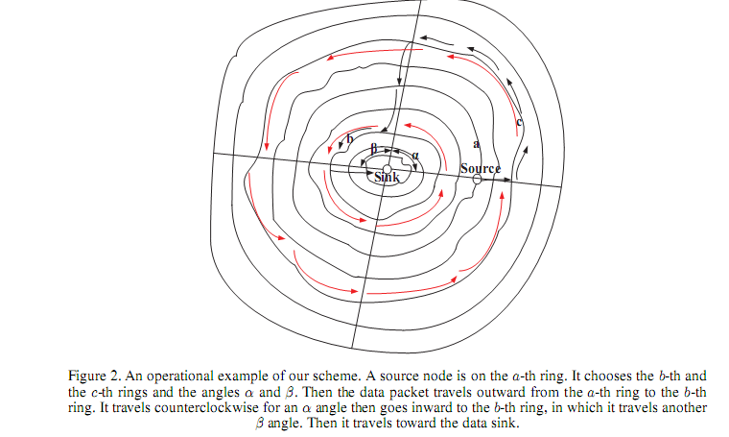
主要思想
数据包的发送

Slide 35
主要思想
假包的产生
想法：当数据包经过环上的节点时，让环上的邻居节点产生假包来迷惑攻击者，邻居节点包括远邻居和近邻居节点（即外一环和内一环）；为了节省能量，邻居节点以一定的概率产生假包。
假包的传输
假包的传输路径和真包的传输路径基本是一样的，只不过假包的TTL限制会比真包更大，即TTL值小（真包也应该有TTL），但是不会传输到sink，最终在环中消亡。并且真包和假包在环中的传输方向是一样的，以此来避免冲突。
怎样来实现保护的？主要采用随机和假包策略来迷惑攻击者，其中随机性是为了迷惑traffic analysis attack中的rate monitoring attack，而假包策略主要是为了迷惑packet tracing和traffic analysis attack中的time correlation attack的。

Slide 36
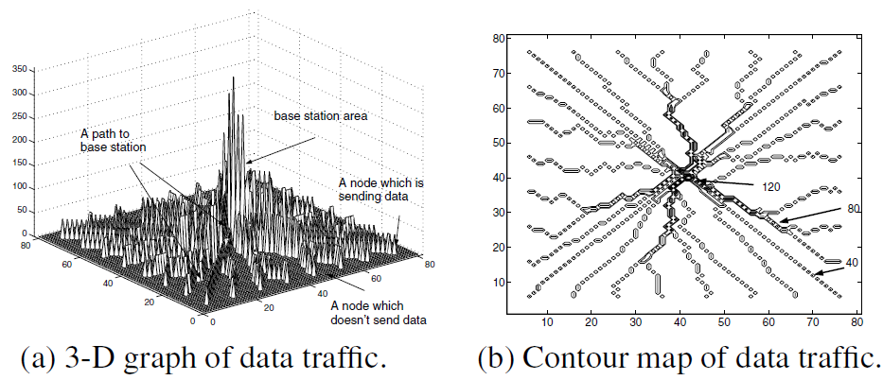
Improvement（5）:
SINK Privacy
流量分析主要用来保护Base Station的，因为其附近的流量较大，所有的数据包都要发送给Base Station，而源节点个数较大且相对比较分散。
Dalian University of Technology, China

Slide 37
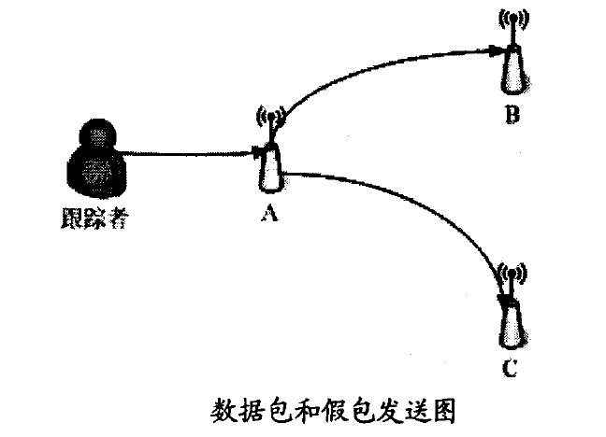
Fake Sink(1)
基本思想
利用数据包随机转发策略和假包策略来达到保护汇聚节点位置隐私的目的。该策略的主要思想是利用随机转发策略延长数据包在网络中转发的路径长度，利用假包策略将攻击者引向远离汇聚节点的错误方向。
  传感器节点将自己的邻居节点分为
  远邻居和近邻居集合。节点接收到
  数据包后以一定的概率pfake随机
  选择一个远邻居产生并发送一个假
  包。

Slide 38
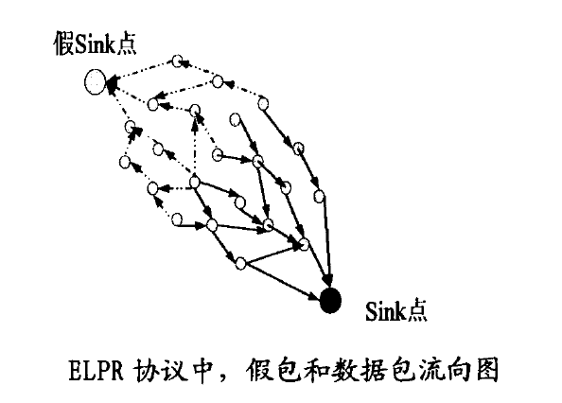
Fake Sink(2)
基本思想
在无线传感器网络部署区域内与真实sink点相距较远的位置设置假sink点，网络中就会形成两个方向完全相同的数据流，攻击者就会以更高的概率被引向假sink节点。

Slide 39
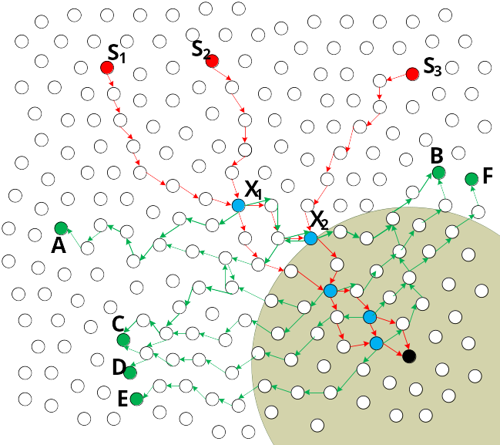
Fake sinks(3)
Three Stages
Only the real packets are sent
along the routing path.
The first intersection node sends
fake packets to fake sinks
The other intersection nodes
send fake packets to random
destinations.
In order to ensure that the fake sinks have almost the same traffic as the real one, only the first intersection node sends fake packets to fake sinks. Moreover, random destinations are selected to ensure the path complexity.

Slide 40
Related Work
3, Dummy data injection
The basic idea is to perturb traffic by sending fake packets
1, Flooding
In baseline flooding,...
In probabilistic flooding, ...
In phantom flooding,..
4, Fake data source
To simulate the behavior of a real data source in order to confuse the adversaries so that real data source can be protected.
Related
Methods
2, Random walk
Random walk, performs a few steps of random walk from data source to protect the original one. Then, the messaged is sent to sink by a single path.
5, Fake sinks

Slide 41
Thank You !

